Slide 1
ECE 551 Digital Design And Synthesis
Spring’19
Lecture 1
Instructor Introduction
Course Introduction
Administrative Stuff
Introduction to Verilog

Slide 2
Instructors
Eric Hoffman
Faculty Associate
Have no PhD, Masters only
25+ years industry experience doing Integrated Circuit & System design
10 years at Intel
7+ years at ZMD (Mixed signal, Analog/Digital IC’s)
8+ years as independent consultant
Instructing experience:
ECE555, ECE552, ECE551, ECE353, ECE352
Fego Ahia= TA
ahia@wisc.edu

Slide 3
Instructor and TA Office Hours
Eric Hoffman
Office = EH2358, if not there then check 3654 or possibly B555
Hours
MWF 1:30 to 3:00. (also around other times. If door all the way open feel free)
Email = erichoffman@wisc.edu
TA = Fego Ahia
Office Hours = Held in B555 (basement unix lab)
Monday & Tuesday 4:00 to 5:00
Available via email: ahia@wisc.edu
Discussion Session hosted by Fego
Tuesday 6:00 – 7:00PM, Room is 2535
Some weeks discussion will be tutorials, in which case room is B555
In fact your fist discussion will be ModelSim Tutorial in B555

Slide 4
Course Goals
Provide knowledge and experience in:
Digital circuit design using a HDL (Verilog & SVerilog)
HDL simulation
Good practices in digital design verification
How to build self checking test benches
How to evaluate test suite using coverage tools
Synthesis of dataflow and behavioral designs
Optimizing hardware designs (timing, area, power)
Basic static timing analysis concepts
Design tools commonly used in industry
Teach you to be able to “think hardware” first, then code it in an HDL.

Slide 5
Course Structure (not inverted, not standard)
Some Video Lectures (with subsequent quizzes)
Some Classroom Lectures (usually one a week)
Class room exercises with: ModelSim/Quartus/Synopsys
In class exercises
Most individual, some as team of 2, some as project team
Verilog DUT and testbench creation & simulation
Sometimes mapping it to Altera FPGA (DE0 Nano)
Sometime mapping it to std cell (Synopsys)
First 2 classes will be lectures because we have to have background before exercises practical.

Slide 6
What You Should Already Know
Principles of basic digital logic design (ECE 352)
Number representations (unsigned, signed, Hex & Binary)
Boolean algebra
Gate-level design
K-Map minimization
Finite State Machines
Basic datapath structures (adders, shifters, SRAM)
How to log in to CAE machines and use a Linux shell

Slide 7
Course Website
Canvas webpage: (canvas.wisc.edu/courses/140578)
What the Website will have:
Lecture Notes (I will try to stay 1 week ahead of class)
Lecture Videos and Quizzes
Homework Assignments
In Class Exercise Descriptions
Tutorials
Project Information
Supplemental Information
Midterm Solution

Slide 8
Course Materials
Lecture Slides
No Textbook Necessary
Can get by with the Standards & Lecture slides
Standards
IEEE Std.1364-2001, IEEE Standard Verilog Hardware Description Language, IEEE, Inc., 2001.
IEEE Std 1364.1-2002, IEEE Standard for Verilog Register Transfer Level Synthesis, IEEE, Inc., 2002
Synopsys on-line documentation
Other useful readings
Will have to buy a DE0 Nano FPGA board.
Pair up with someone and buy one for group of two.
Can rent for $35 or buy for $70

Slide 9
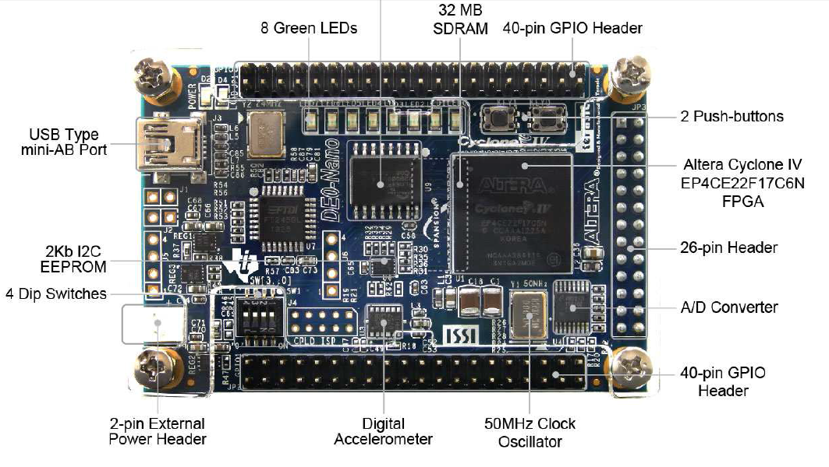
DE0-Nano (Altera FPGA Board)

Slide 10
Evaluation and Grading
Approximately:
12.5% Homework
10% Quizzes on video lectures (lowest 1 score dropped)
8% In class exercise results (lowest 2 scores dropped)
1.5% Cummings paper quiz
28% Project (groups of 3 or 4) (Establish team soon)
20% Midterm
20% Final
Graded on a curve. Class average grade will be around 3.25
Homework due before of class period of due date
15% penalty for each late period of 24 hours
Not accepted >48 hours after deadline
Will be done as Canvas Quizzes or dropboxes.

Slide 11
Class Project
Work in groups of 3 or 4 students
Design, model, simulate, synthesize, and test a complex digital system.
Several milestones
Forming teams
Homework problems that build toward the project
Project status report
Final demonstration (including mapping to your DE0 Nano)
More details coming later in the course

Slide 12
Course Tools
Industry-standard design tools:
Modelsim HDL Simulation Tools (Mentor)
Design Vision Synthesis Tools (Synopsys)
TSMC 45nm CMOS Standard Cell Technology Library
Tutorials will be available for both tools
Modelsim tutorials next week, (only attend one of these)
Monday 6:00 – 7:30 held in B555
Tuesday 6:00 – 7:30 held in B555
Wednesday 4:00 – 5:30 held in B555
Design Vision tutorial a 6 to 7 weeks later
Tool knowledge will be required to complete homeworks
Fego Ahia will be a resource for help on tools

Slide 13
ModelSim Tutorial
ModelSim is our Verilog simulator.
Tutorial takes about 1 to 1.5 hours
3 tutorial sessions will be held next week (only attend one)
Monday Jan 28th 6:00 – 7:30 in B555
Tuesday, Jan 29th 6:00 – 7:00 in B555
Wednesday, Jan 30th 4:00 – 5:30 in B555
You only need to attend one of these sessions!
You can also do it on your own if you can’t make any of these sessions.

Slide 14
What You Should Get From This Class
This class will teach you how to use Hardware Description Languages (HDLs) to design, verify, and realize digital logic
You will learn how to synthesize HDLs into hardware using the same tools used in industry
You will participate in the always enlightening process of working to design a digital system in a team environment
By the end of this course, most of you should be qualified for an entry-level job or internship at a hardware design firm ($$$)

Slide 15
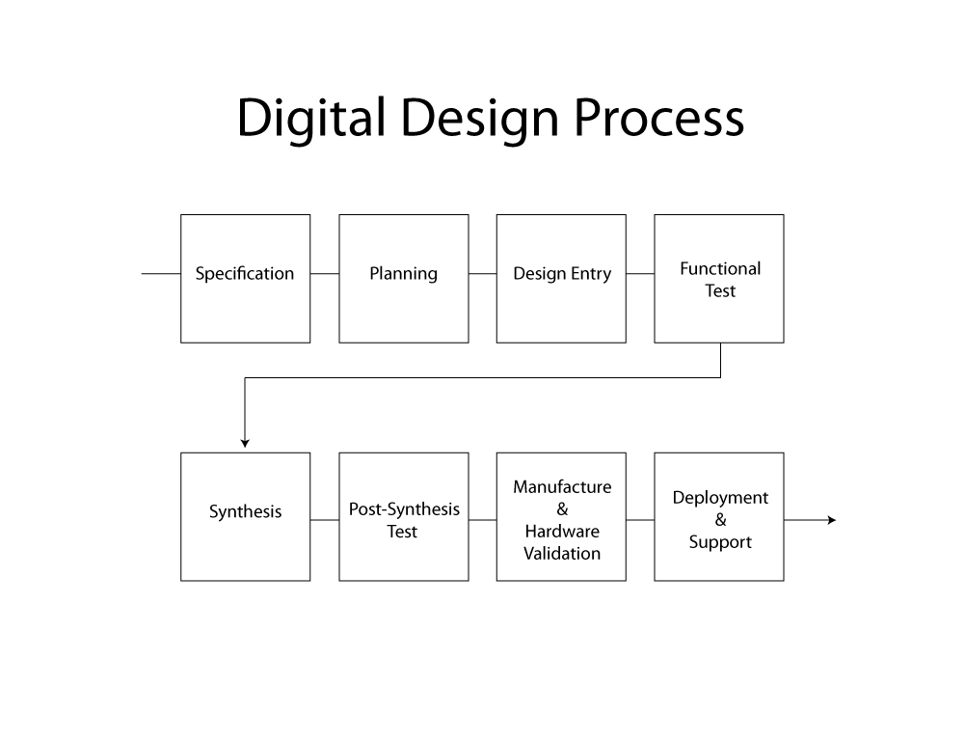
APR, Parasitic Extraction
& Timing Checks
Manufacture
&
Hardware
Validation

Slide 16
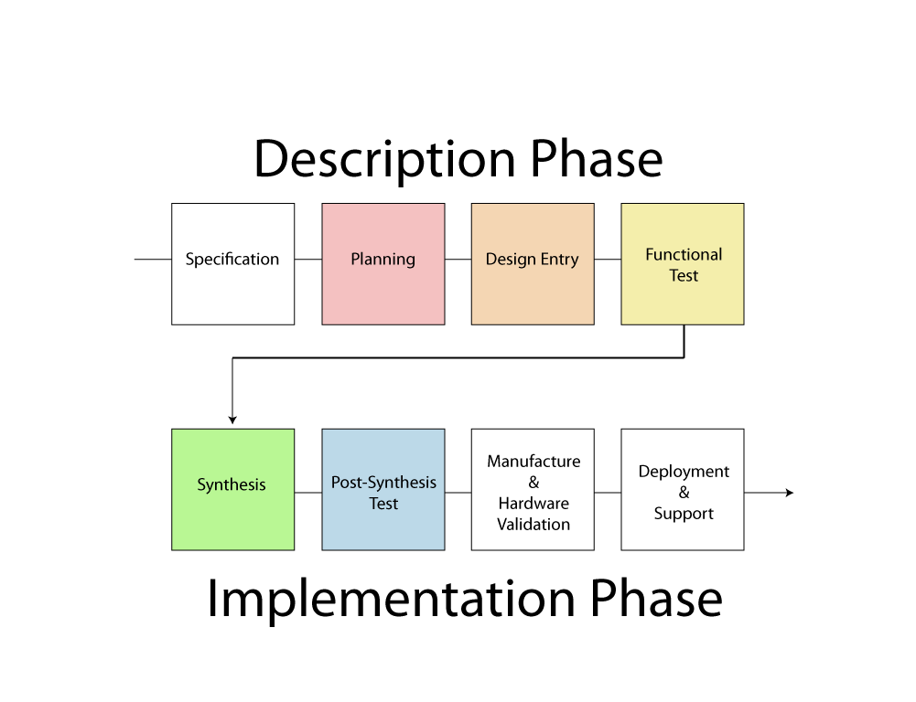
APR, Parasitic Extraction
& Timing Checks
Manufacture
&
Hardware
Validation

Slide 17
What is an HDL?
HDL = Hardware Description Language
Allows for modeling & simulation (with timing) of digital designs
Can be synthesized into hardware (netlist) by synthesis tools (Synopsys, Ambit, FPGA compilers)
Two major standards in industry & academia
Verilog (Flexible, loose, more common in industry)
VHDL (Strongly typed, more common in defense and automotive)
Having used both I prefer Verilog. This course will use Verilog
System Verilog (Sverilog) is the next generation of verilog, and we will be learning portions of system verilog as well.

Slide 18
What is an HDL? (continued)
module counter(clk,rst_n,cnt);
input clk,rst_n;
output [3:0] cnt;
reg [3:0] cnt;
always @(posedge clk) begin
if (!rst_n)
cnt <= 4’b0000;
else
cnt <= cnt+1;
end
endmodule
It looks like a programming language
It is NOT a programming language
It is always critical to recall you are describing hardware
This codes primary purpose is to generate hardware
The hardware this code describes (a counter) can be simulated on a computer. In this secondary use of the language it does act more like a programming language.

Slide 19
Simulating/Validating HDL
The sad truth…
10% design, 90% validation
If you do it right you will spend 9X more time testing/validating a design than designing it.
Testbenchs are written in verilog as well.
Testbench verilog is not describing hardware and can be thought of as more of a program.
Stimulus
Generation
(verilog)
Design
Under Test
(verilog)
Output
Monitoring
Self Checking
(verilog)
file
Verilog test bench shell
file

Slide 20
What is Synthesis?
Takes a description of what a circuit DOES
Creates the hardware to DO it
Output is actually a text
netlist, not a GUI schematic
form.
module counter(clk,rst_n,cnt);
input clk,rst_n;
output [3:0] cnt;
reg [3:0] cnt;
always @(posedge clk) begin
if (~rst_n)
cnt <= 4’b0000;
else
cnt <= cnt+1;
end
endmodule
Synthesis Tool
(Synopsys)
Increment
Combinational
Logic
4
rst_n
4
4
cnt[3:0]
clk

Slide 21
Synthesizing the Hardware Described
All hardware created during synthesis
Even if a is true, still computing d&e
Learn to understand how descriptions translated to hardware
if (a) f = c & d;
else if (b) f = d;
else f = d & e;
c
f
d
e
b
a

Slide 22
Why Use an HDL?
Enables Larger Designs
More abstracted than schematics, allows larger designs.
Register Transfer Level Description
Wide datapaths (16, 32, or 64 bits wide) can be abstracted to a single vector
Synthesis tool does the bulk of the tedious repetitive work vs schematic capture
Work at transistor/gate level for large designs: cumbersome
Portable Design
Behavioral or dataflow Verilog can be synthesized to a new process library with little effort (i.e. move from 0.11μ to 45nm process)

Slide 23
Why Use an HDL? (continued)
Portable Design (continued)
Verilog written in ASCII text. The ultimate in portability. Much more portable than the binary files of a GUI schematic capture tool.
Explore larger solution space
Synthesis options can help optimize (power, area, speed)
Synthesis options and coding styles can help examine tradeoffs
Speed
Power
area

Slide 24
Why Use an HDL? (continued)
Better Validated Designs
Verilog itself is used to create the testbench
Flexible method that allows self checking tests
Unified environment
Synthesis tools are very good from the boolean correctness point of view
If you have a logic error in your final design there is a 99.999% chance that error exists in your behavioral code
Errors caused in synthesis fall in the following categories
Timing
Bad Library definitions
Bad coding style…sloppyness

Slide 25
Other Important HDL Features
Are highly portable (text)
Are self-documenting (when commented well)
Describe multiple levels of abstraction
Represent parallelism
Provides many descriptive styles
Structural
Register Transfer Level (RTL)
Behavioral
Serve as input for synthesis tools

Slide 26
Hardware Implementations
HDLs can be compiled to semi-custom and programmable hardware implementations
Full Custom
Semi-Custom
Programmable
Manual VLSI
Standard Cell
Gate Array
FPGA
PLD
less work, faster time to market
implementation efficiency

Slide 27
Hardware Building Blocks
G
Transistors are switches
Use multiple transistors to make a gate
Use multiple gates to make a circuit
D
S
A
A
A
A

Slide 28
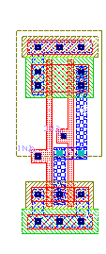
Standard Cells
Library of common gates and structures (cells)
Decompose hardware in terms of these cells
Arrange the cells on the chip
Connect them using metal wiring
…

Slide 29
FPGAs
“Programmable” hardware
Use small memories as truth tables of functions
Decompose circuit into these blocks
Connect using programmable routing
SRAM bits control functionality
FPGA Tiles
P1
P2
P
P3
OUT
P4
P5
P6
P7
P8
I1
I2
I3

Slide 30
What is a Netlist?
A netlist is a ASCII text representation of the interconnect of a schematic
Many Standards Exist:
Spice Netlist
EDIF (Electronic Data Interchange Format)
Structural Verilog Netlist (this is what we will use)
module comb(Z,A,B,C);
input A,B,C;
output Z;
wire n1, n2;
and02d1 A1(n1,A,B);
inv01d1 I1(n2,C);
and02d1 A2(Z,n1,n2);
endmodule
A
comb
n1
A1
=
B
A2
C
I1
n2
Z

Slide 31
Review: Combinational Logic
Since HDLs try to abstract hardware design, do we even have to consider the hardware?
Good hardware design requires ability to analyze a problem to find simplifications
Multiple variables: throughput, area, latency, power
Finding an optimal hardware implementation is a computationally complex problem. The synthesis tools need guidance on where to start
Optimization issues
if(x != 0) vs. if((x <= -1) || (x >= 1))
What hardware might this generate?

Slide 32
Verilog Module
A[1:0]
In Verilog, a circuit is a module.
2
Decoder
2-to-4
module decoder_2_to_4 (A, D) ;
input [1:0] A ;
output [3:0] D ;
assign D = (A == 2'b00) ? 4'b0001 :
(A == 2'b01) ? 4'b0010 :
(A == 2'b10) ? 4'b0100 :
(A == 2'b11) ? 4'b1000 ;
endmodule
4
D[3:0]

Slide 33
Verilog Module
A[1:0]
module name
ports names of module
2
Decoder
2-to-4
module decoder_2_to_4 (A, D) ;
input [1:0] A ;
output [3:0] D ;
assign D = (A == 2'b00) ? 4'b0001 :
(A == 2'b01) ? 4'b0010 :
(A == 2'b10) ? 4'b0100 :
(A == 2'b11) ? 4'b1000 ;
endmodule
port types
port sizes
4
D[3:0]
module contents
keywords underlined

Slide 34
Declaring A Module
Can’t use keywords as module/port/signal names
Choose a descriptive module name
Indicate the ports (connectivity)
Declare the signals connected to the ports
Choose descriptive signal names
Declare any internal signals
Write the internals of the module (functionality)

Slide 35
Good HDL “Self Comments”
module xyz123 (A, B) ;
input [3:0] A ;
output B ;
//module contents
endmodule
BAD
module doomsday_machine (crystals, earthquake) ;
input [3:0] crystals ;
output earthquake ;
//module contents
endmodule
GOOD
35

Slide 36
Declaring Ports
A signal is attached to every port
Declare type of port
input
output
inout (bidirectional)
Scalar (single bit) - don’t specify a size
input cin;
Vector (multiple bits) - specify size using range
Range is MSB to LSB (left to right)
Don’t have to include zero if you don’t want to… (D[2:1])
output [7:0] OUT;
input [0:4] IN;

Slide 37
Module Styles
Modules can be specified different ways
Structural – connect primitives and modules
Dataflow– use continuous assignments
Behavioral – use initial and always blocks
A single module can use more than one method!
What are the differences?

Slide 38
Structural
A schematic in text form (i.e. A netlist)
Build up a circuit from gates/flip-flops
Gates are primitives (part of the language)
Flip-flops themselves described behaviorally
Structural design
Create module interface
Instantiate the gates in the circuit
Declare the internal wires needed to connect gates
Put the names of the wires in the correct port locations of the gates
For primitives, outputs always come first

Slide 39
Structural Example
module majority (major, V1, V2, V3) ;
output major ;
input V1, V2, V3 ;
wire N1, N2, N3;
and A0 (N1, V1, V2),
A1 (N2, V2, V3),
A2 (N3, V3, V1);
or Or0 (major, N1, N2, N3);
endmodule
V1
N1
A0
V2
V2
A1
N2
Or0
major
V3
V3
A2
N3
V1
majority

Slide 40
RTL Example
module majority (major, V1, V2, V3) ;
output major ;
input V1, V2, V3 ;
assign major = V1 & V2
| V2 & V3
| V1 & V3;
endmodule
majority
V1
V2
major
V3

Slide 41
Behavioral Example
module majority (major, V1, V2, V3) ;
output reg major ;
input V1, V2, V3 ;
always @(V1, V2, V3) begin
if (V1 && V2 || V2 && V3
|| V1 && V3) major = 1;
else major = 0;
end
endmodule
majority
V1
V2
major
V3

Slide 42
FSM Review
Combinational and sequential logic
Often used to generate control signals
Reacts to inputs (including clock signal)
Can perform multi-cycle operations
Examples of FSMs
Counter
Vending machine
Traffic light controller
Bus Controller
Control unit of serial protocol (like RS232, I2C or SPI)

Slide 43
Mealy/Moore FSMs
Mealy
Inputs
Next State
Logic
Output
Logic
Outputs
State Register
Next State
Current State
FF

Slide 44
FSMs
Moore
Output depends only on current state
Outputs are synchronous (but not necessarily glitch free)
Mealy
Output depends on current state and inputs
Outputs can be asynchronous
Change with changes on the inputs
Outputs can be synchronous
Register the outputs
Outputs delayed by one cycle

Slide 45
Remember Bubble Diagrams?
They can be useful. I sometimes will draw a bubble diagram first for a complex FSM. Then code it.
Given the datapath
For a single slope
A2D converter.
Draw a bubble diagram
For a FSM that can control it.
It should run the converter for 8 times and accumulate the 8 results in a 13-bit register. The upper 10-bits of which are used as the result.
Analog_in
-
clr_dac
DAC
Counter
10-bit
DAC
gt
+
inc_dac
10
clk
0
result
13
1
13
10
{000,cnt}
13
clk
clr_smp
Sample
Counter
13
Digital
Compare
To 7
smp_eq_8
inc_smp
clk
accum

Slide 46
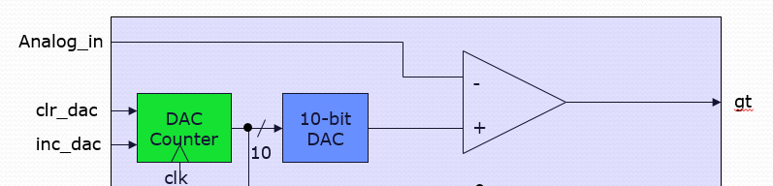
Single Slope A2D Converter:
3.3V
Analog Input=2.75V

Slide 47
Datapath Used to Average:
Analog_in
-
clr_dac
DAC
Counter
10-bit
DAC
gt
+
inc_dac
10
clk
0
result
13
1
13
10
{000,cnt}
13
clk
clr_smp
Sample
Counter
13
Digital
Compare
To 7
smp_eq_8
inc_smp
clk
accum

Slide 48
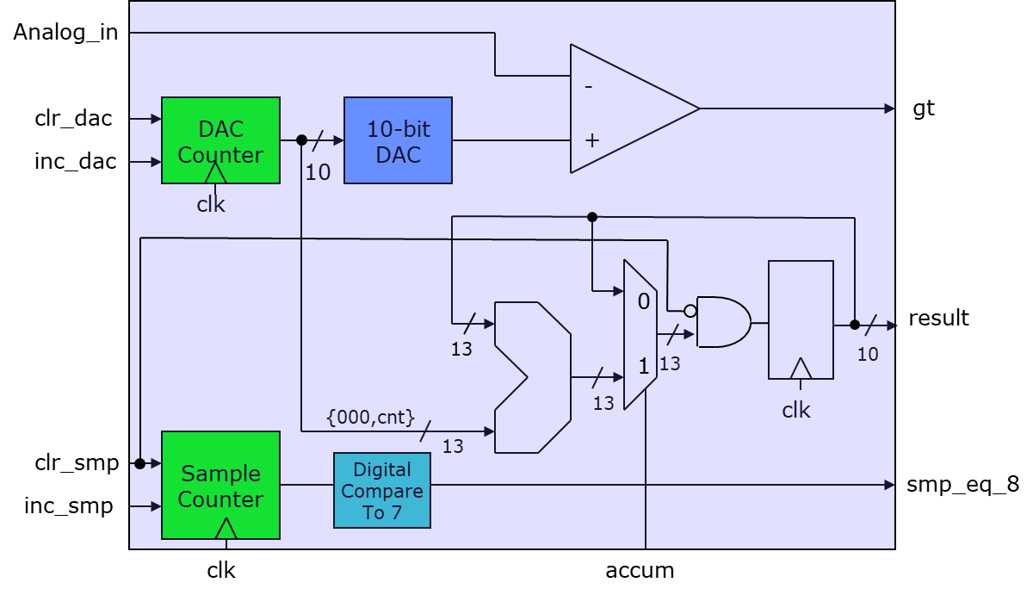
SM Inputs & Outputs
Inputs: | Outputs:
gt | clr_dac
smp_eq_8 | inc_dac
 | clr_smp
 | inc_smp
 | accum
strt_cnv
clk
rst_n
cnv_cmplt

Slide 49
rst_n
strt_cnv/
clr_dac,clr_smp
gt/
inc_dac
,inc_smpl
CNV
IDLE
clr_dac
smp_eq_8/
inc_smpl
accum,
smp_eq_8/
gt/
cnv_cmplt
ACCUM
BUBBLE DIAGRAM

Slide 50
Things to do
Familiarize self with the Moodle webpage
Look at the IEEE Verilog standard on webpage

Slide 51
Review Questions
What are some advantages of using HDLs, instead of schematic capture?
What advantages and disadvantages do standard cell designs have compared to full-custom designs?
What are some ways in which HDLs differ from conventional programming languages? How are they similar?
What are the different styles of Verilog coding?

